Slide 1
Scenarios ADDI Best Practices and Use Cases. Installation, configuration and administration.

Slide 2
Workshop Agenda
Topic
Welcome and Introductions
ADDI administration and project management
Installation, configuration wizard, admin dashboard
Project creation (with and without AD Connect)
Best practice to keep analysis current (build/make/sync)
Dynamic Call resolution?
Automation flows?
Notes:
https://ibm.box.com/s/iluaribb7nxwj09b1vph97kjrlggteql
Objectives:
Learn how to analyze mainframe applications to improve speed and quality of application changes
Be able to automate the synchronization processes to keep your analysis current
Accelerate your modernization journey by identifying API candidates
Generate documentation for regulatory and compliance audits
Learn best practices to set up and maintain your ADDI environment

Slide 3
Our ADDI Scenarios for the first part of the Workshop:
Installation and configuration
ADDI Build Client and Projects
Create and Populate Projects
Check, Build, Build Selection and Incremental Builds

Slide 4
ADDI Installation
Presentation

Slide 5

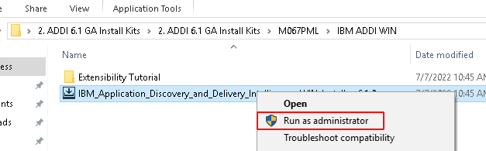
You need to do these steps on the Windows environment provided to you, NOT on your laptop as that will not have the right prereqs.
On the desktop there's a link to folder 2. ADDI 6.1 GA Install Kits. Open this and navigate to the subfolder as shown below.
Right click on that application file and select : "run as administrator"
Follow the screenshots in the next slides.

Slide 6
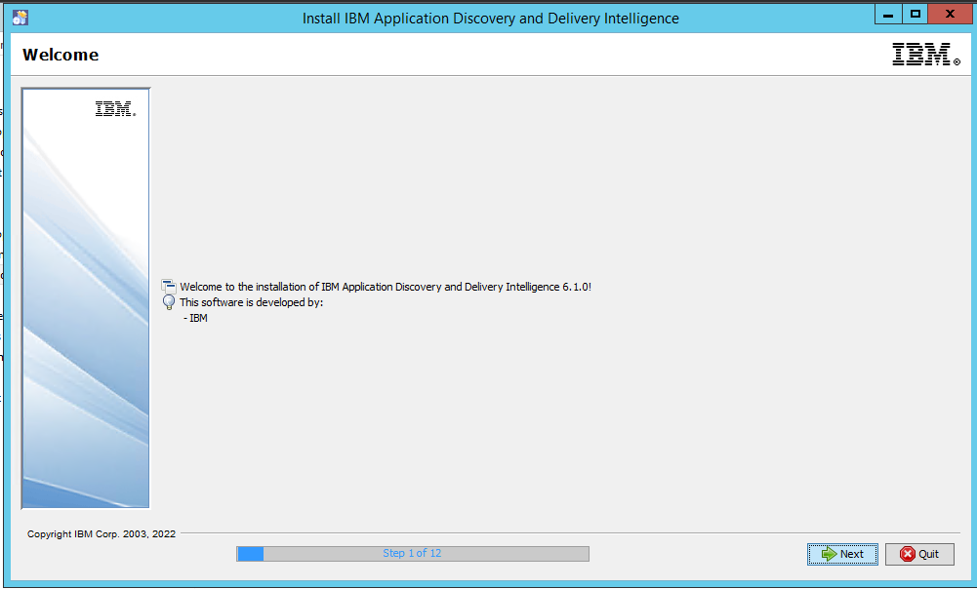

Slide 7
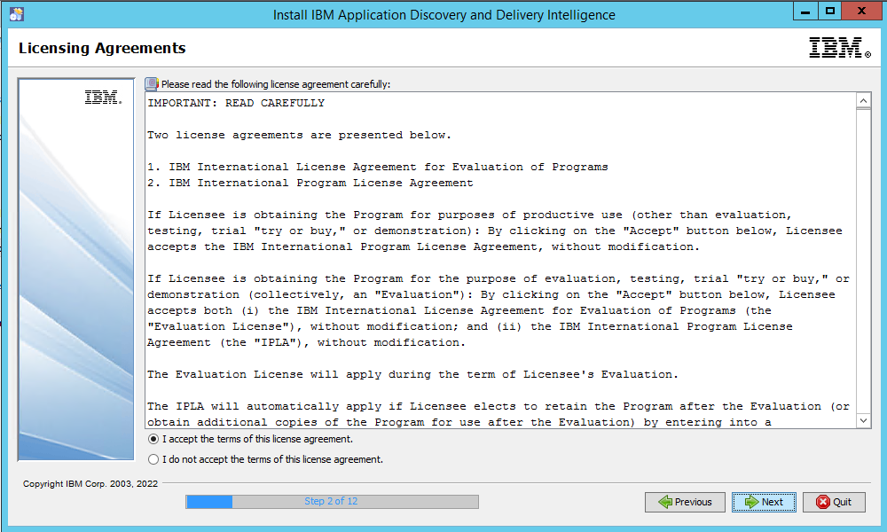

Slide 8
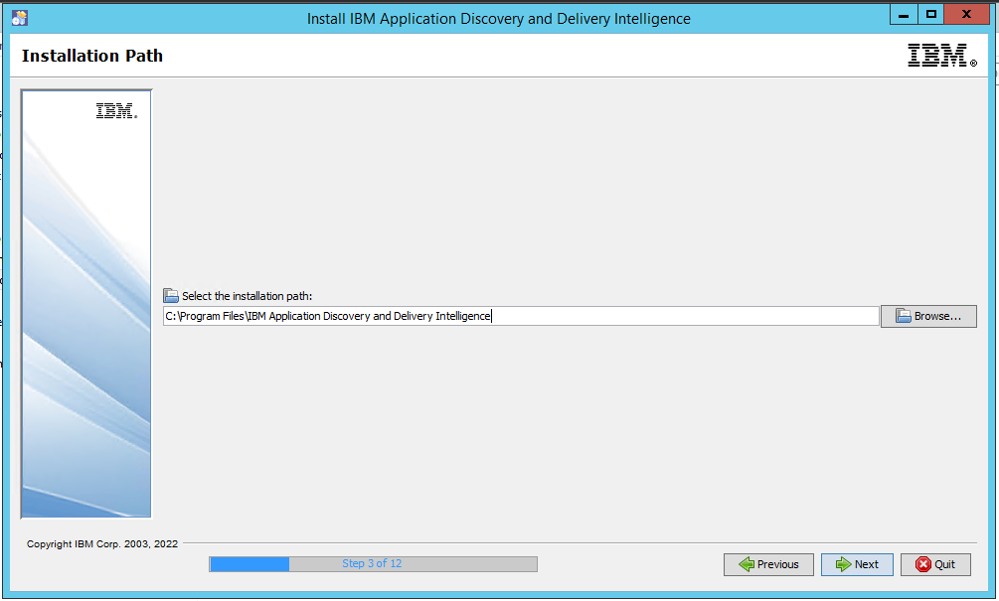

Slide 9
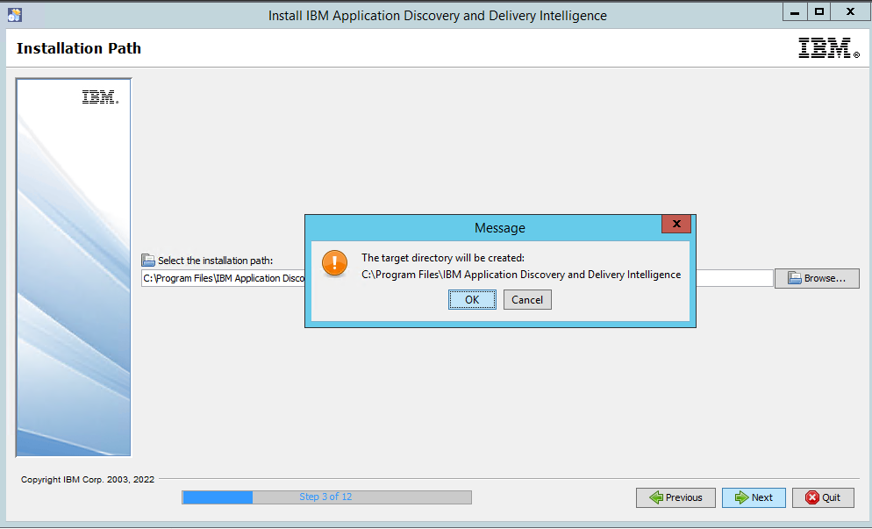

Slide 10
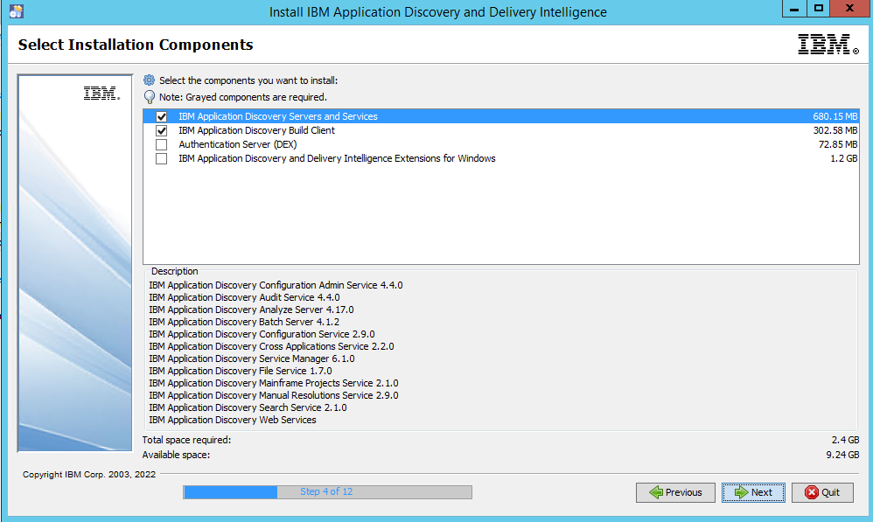

Slide 11
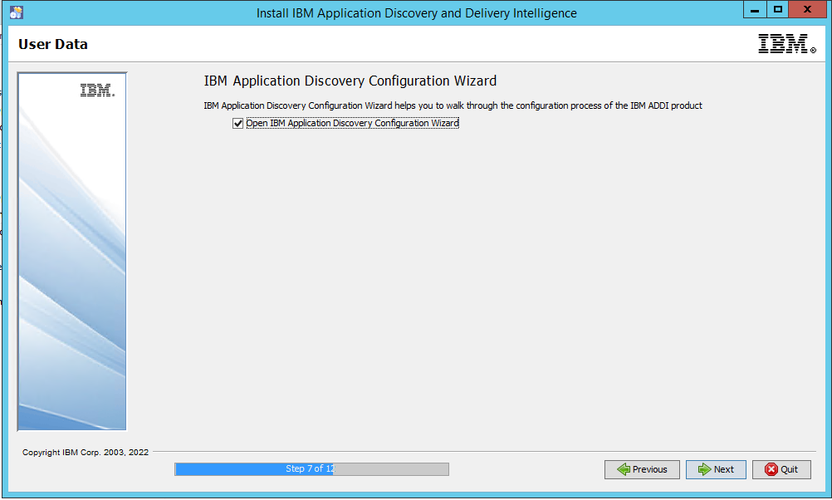

Slide 12
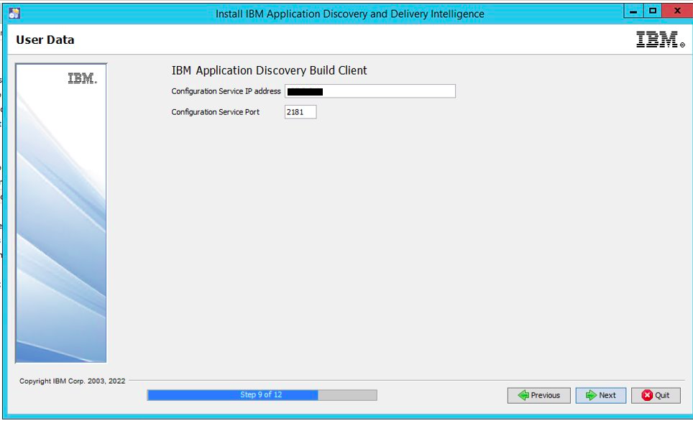
Use your server's IP address

Slide 13
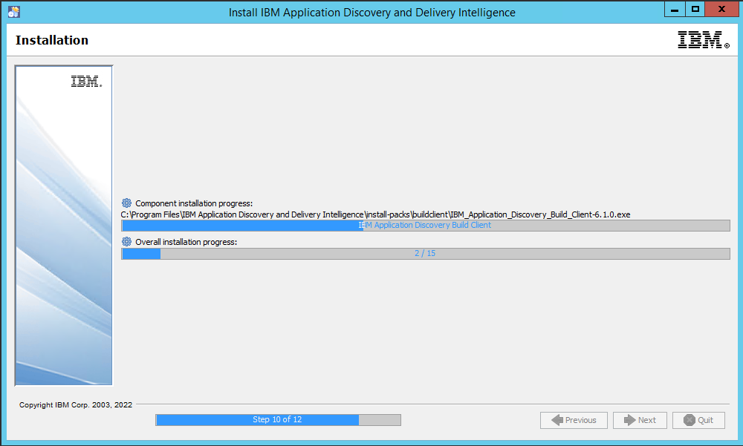

Slide 14
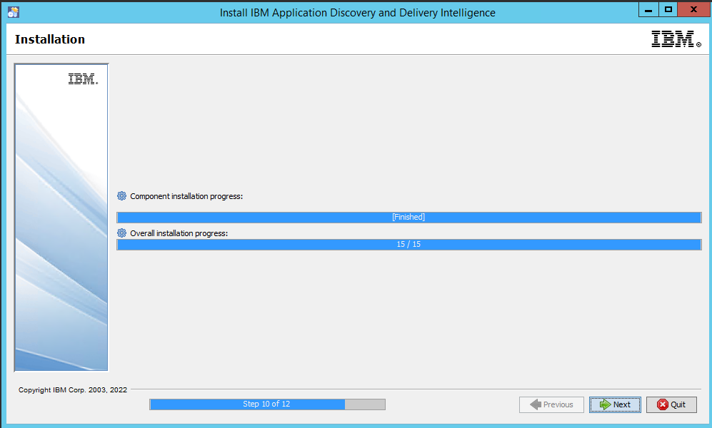

Slide 15
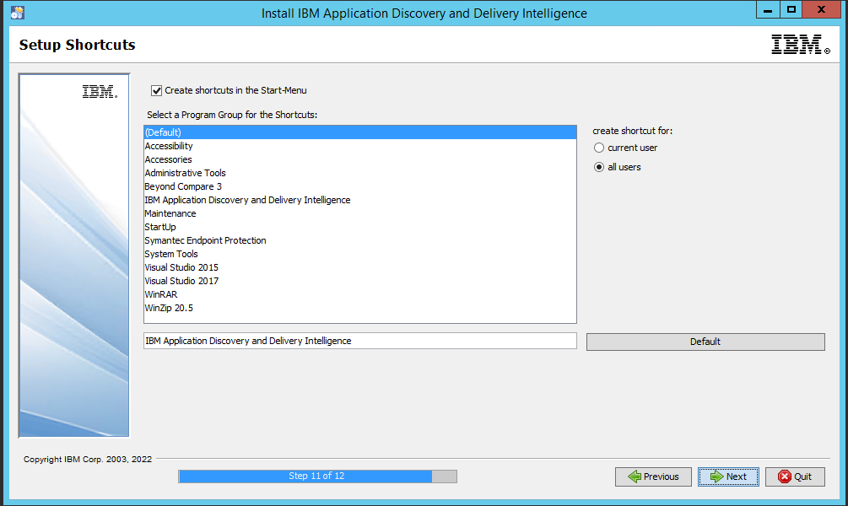

Slide 16
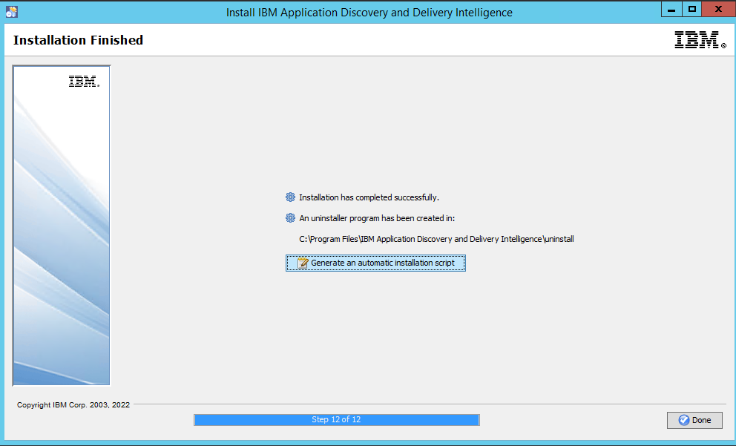

Slide 17
ADDI Configuration Wizard

Slide 18
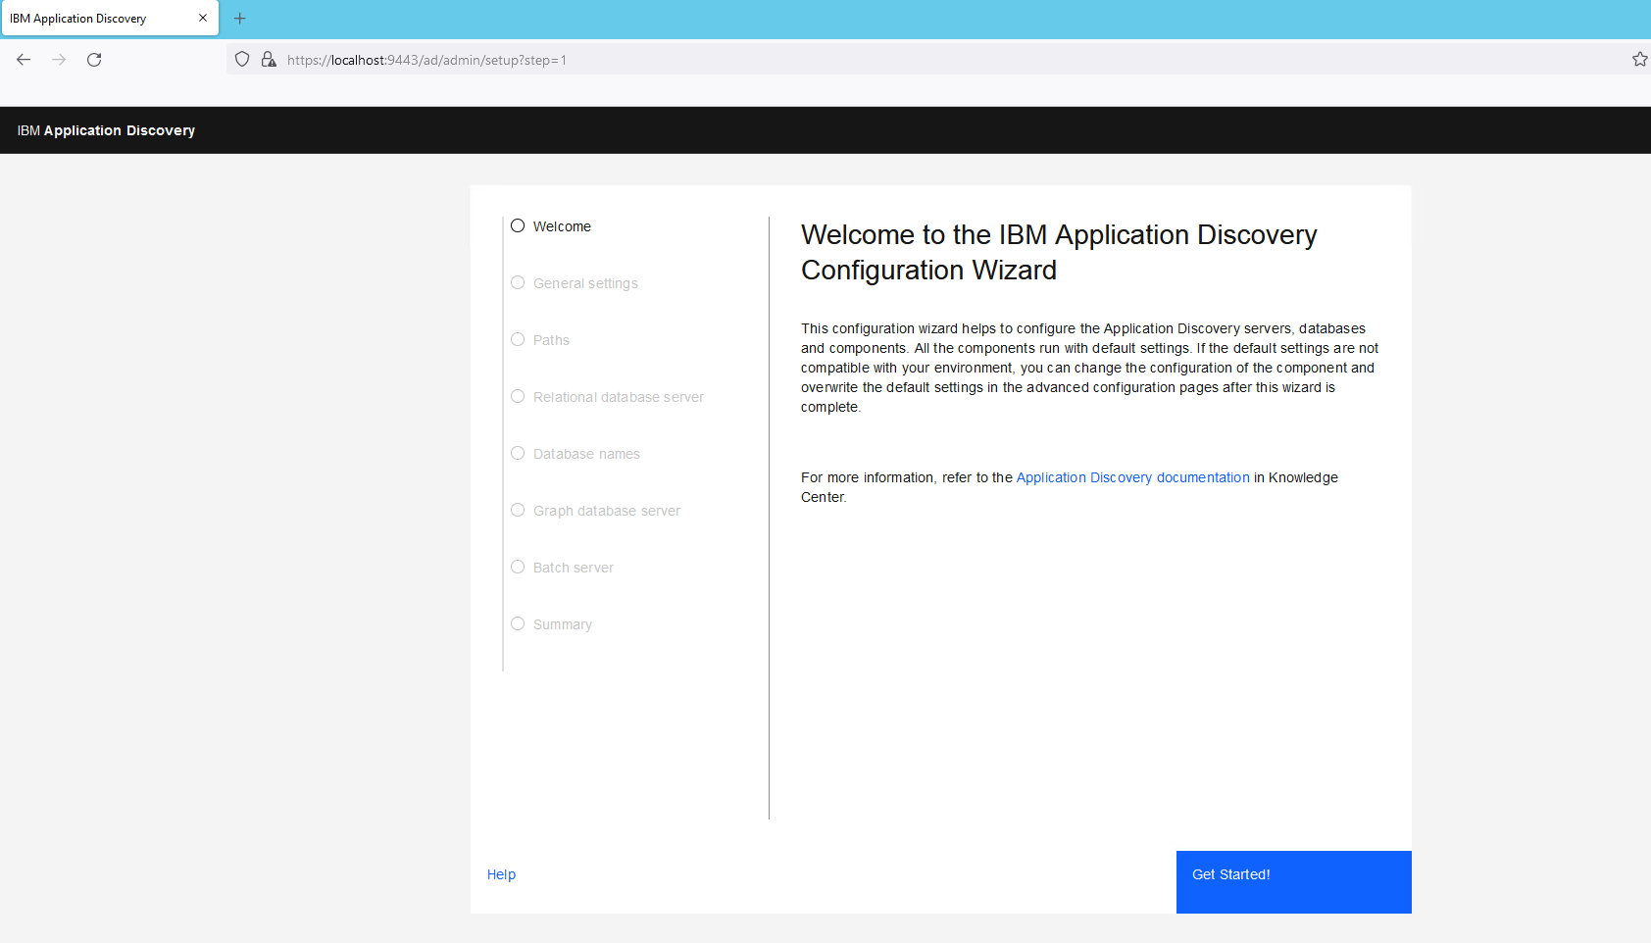

Slide 19
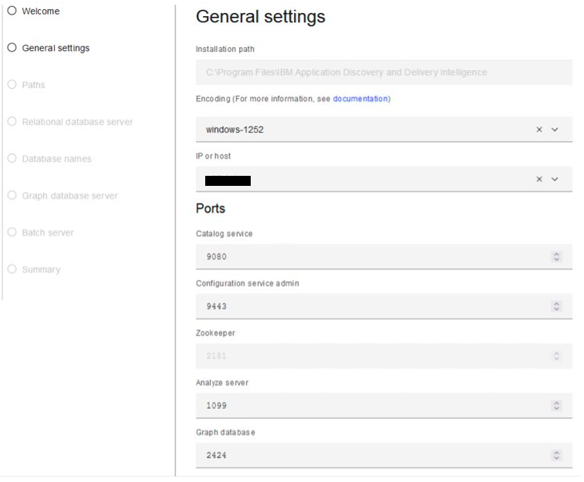
Use your server's IP address

Slide 20
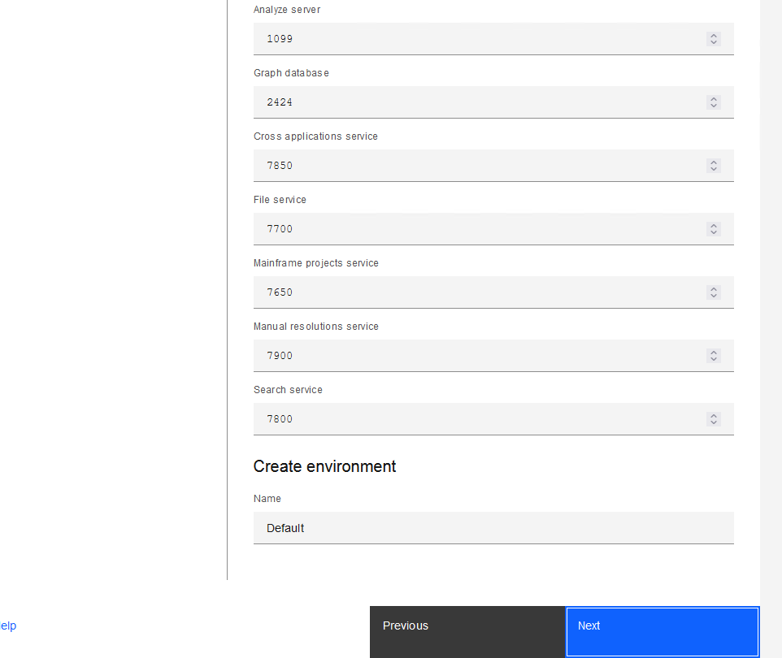

Slide 21
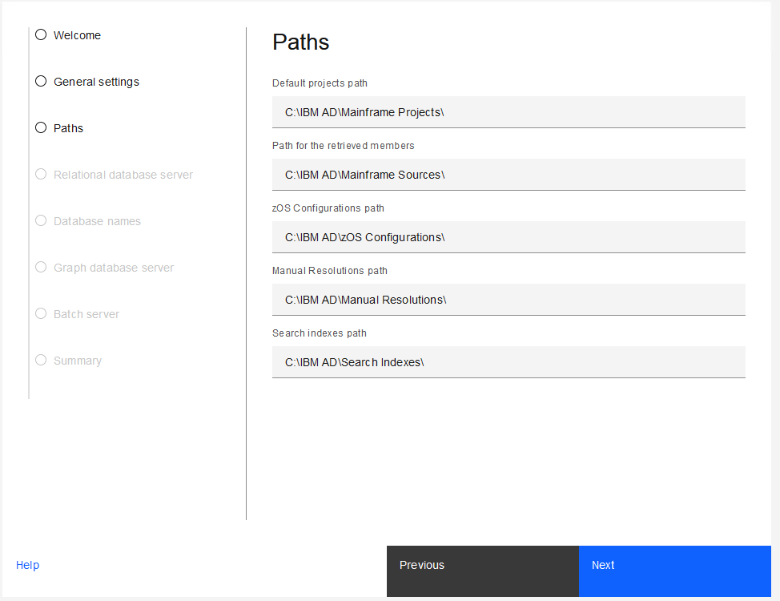

Slide 22
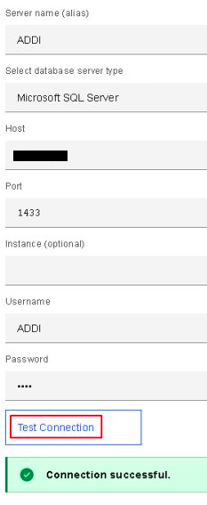
Server name: ADDI
User name: ADDI
Password ADDI
Host: Your server's IP (the actual IP, NOT 127.0.0.1 or localhost)

Slide 23
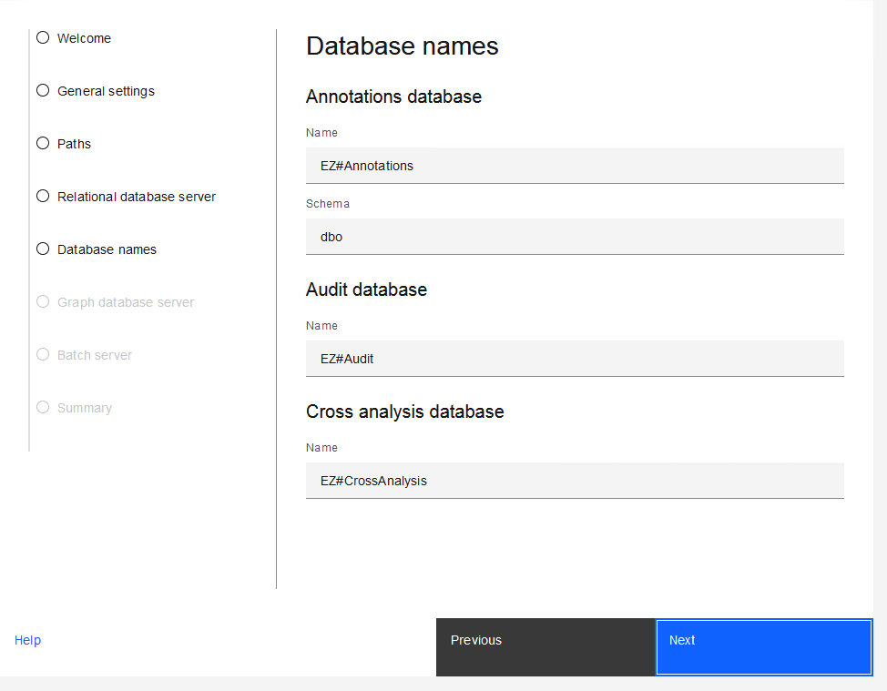
Stick with the defaults given

Slide 24
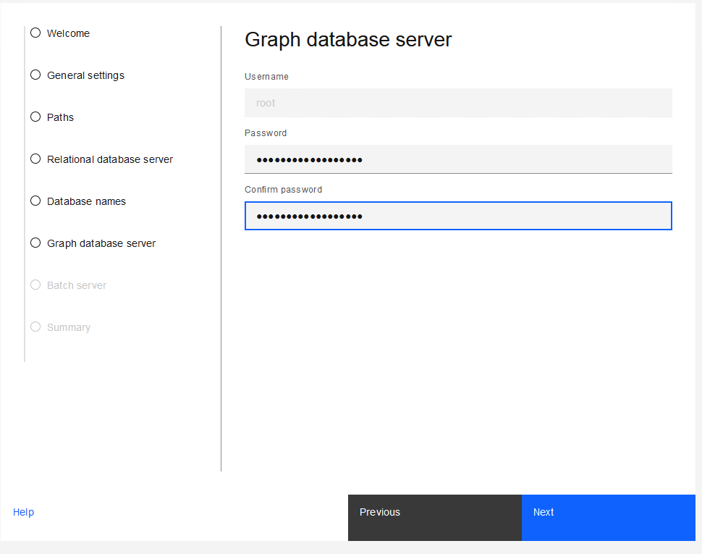
Make a note of the password you choose.

Slide 25
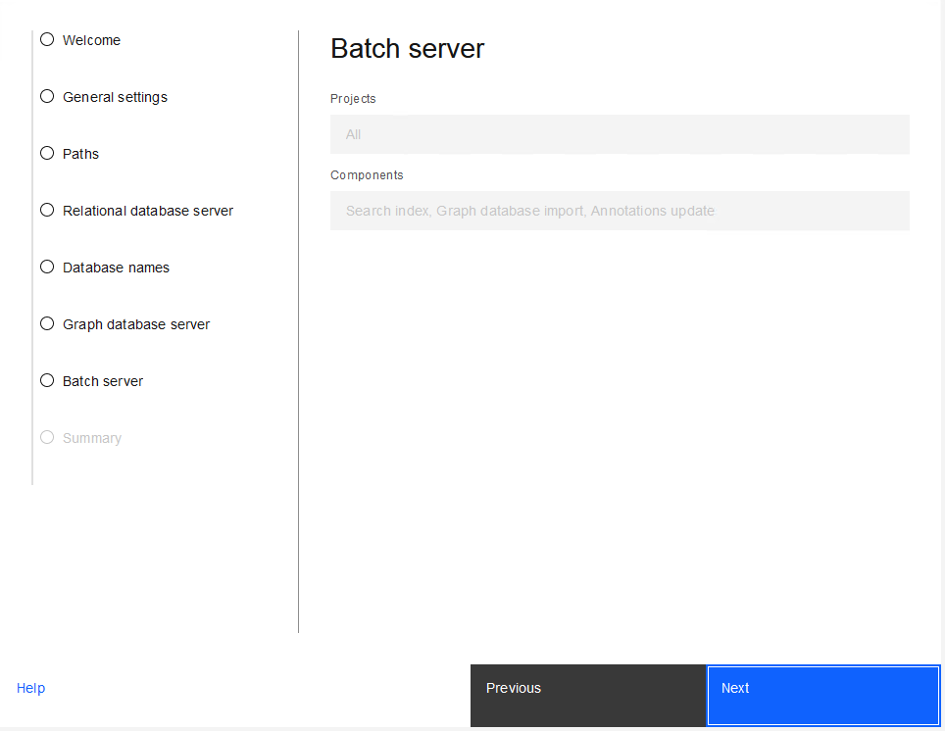

Slide 26
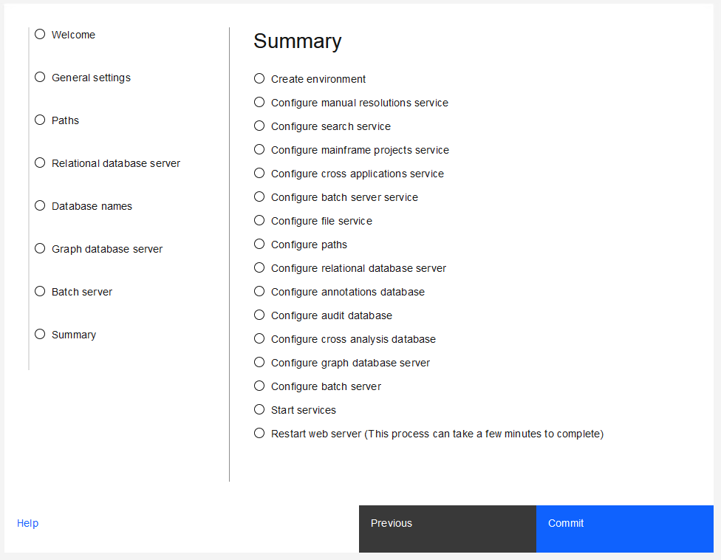

Slide 27
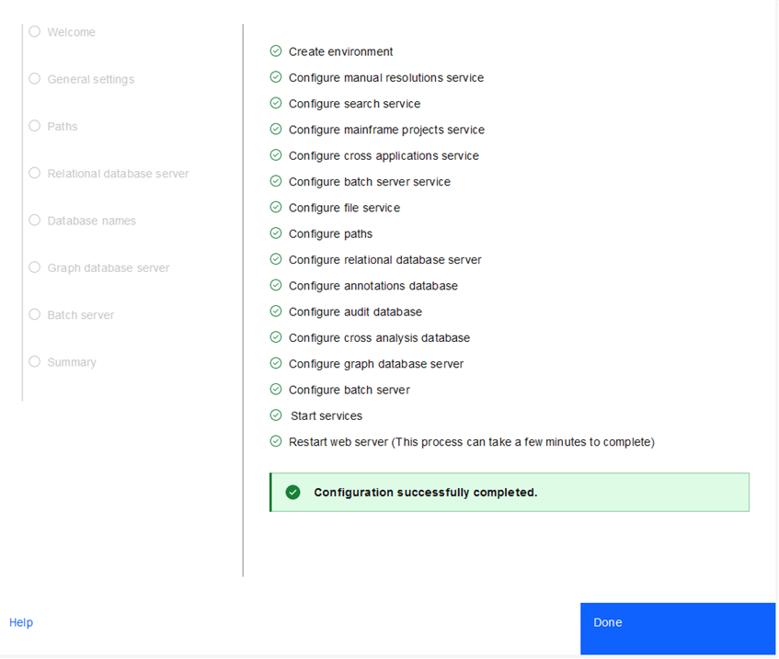

Slide 28
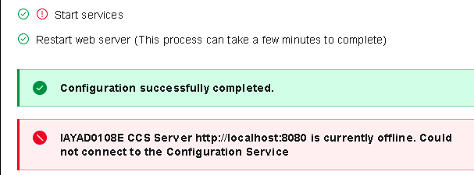
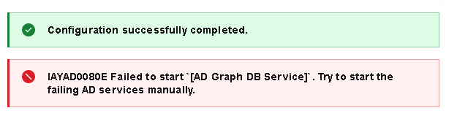
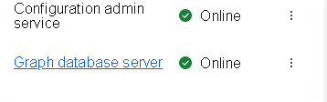
Don't worry if you see something like this, it's probably just a timing issue
In a new browser tab go to your dashboard: https://localhost:9443/ad/admin/dashboard
And select "Monitor". For the screenshot I was actually not even fast enough and it was already running.
If it doesn't go away in a few minutes klick on the three dots on the right to check what's wrong and (re)start tha server if needed.

Slide 29
ADDI Create a Project manually

Slide 30
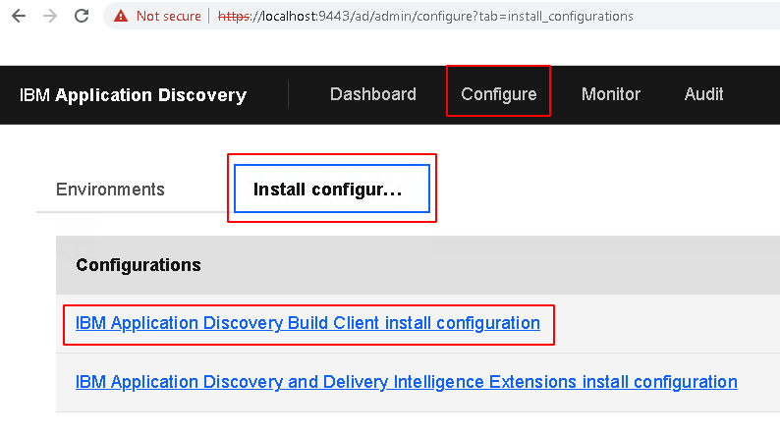
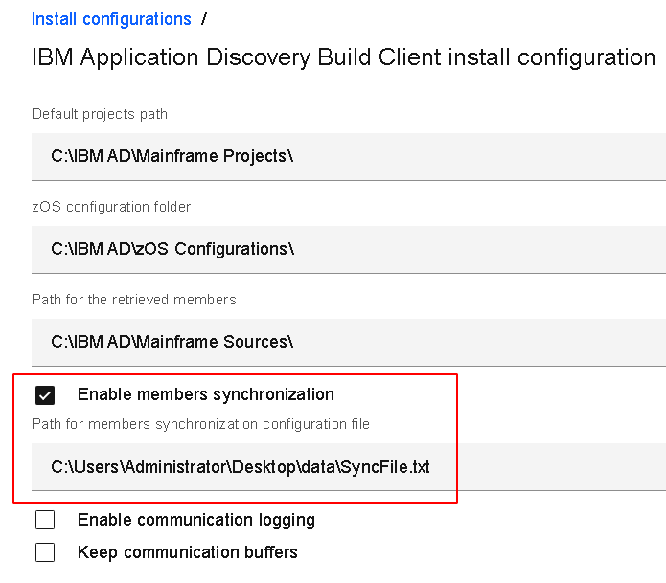

Link to the dashboard:
https://localhost:9443/ad/admin/dashboard
(you might need to accept the security certificate)
In the dashboard select Configure and Install configuration. Click on the highlighted link
Put the path to the sync file in here:
C:\Users\Administrator\Desktop\data\SyncFile.txt
To understand how this file is built up have a look at the file, there's a link to the folder on your desktop:

Slide 31

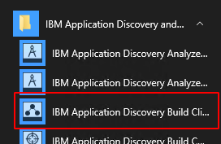
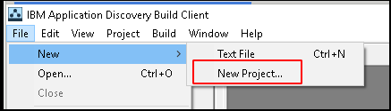
Open the build client via the link created on the dash board, or if that link didn't get created you can find it in the start menu:
In the Built Client create a new project:

Slide 32
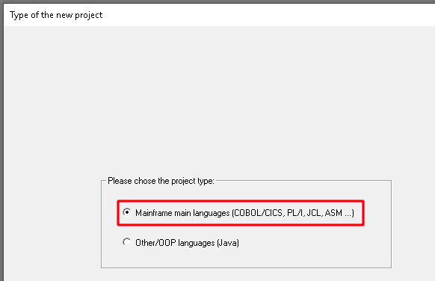
Select Mainframe main languages

Slide 33
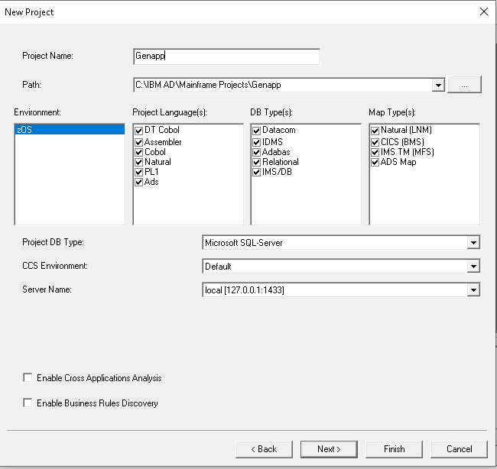
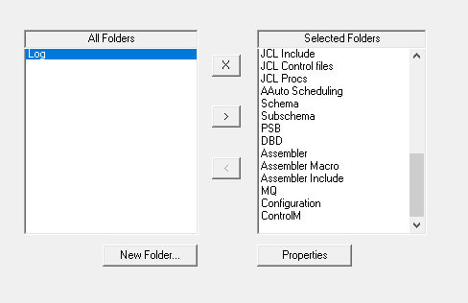
For Genapp fill in the values as shown, then click next. Leave the settings as-is and click finish

Slide 34
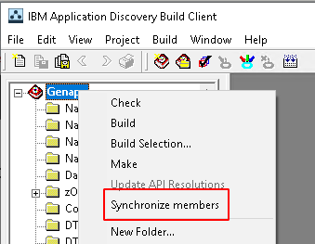
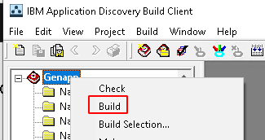
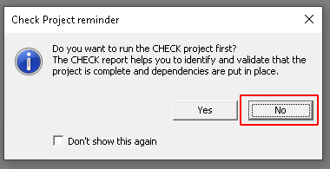
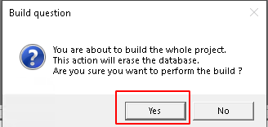
This created the Genapp project, but it's still empty. First synchronise members:
To populate it right click on the project and select "build".
When asked to do a check say "No"
Go grab a cup of coffee as this may take a few minutes (or, in real life with a much larger project even a few hours or longer). There is a small message at the bottom saying it's working (it's hard to miss and think it's not doing anything).

Slide 35
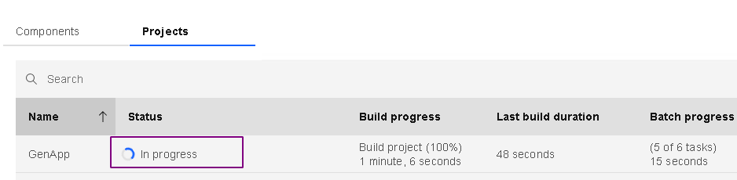

In the dashboard, in Monitor -> Projects keep refreshing until Status is "Ready for analysis

Slide 36
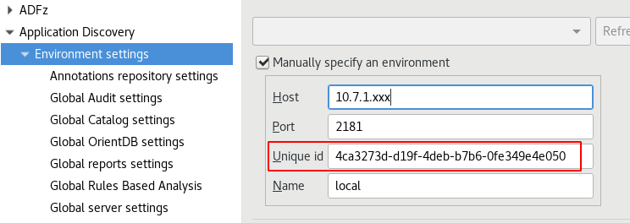
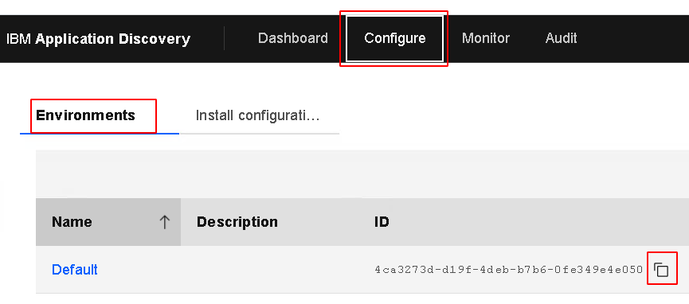
Configuring IDz
Do this in your shared Windows server but you can also do it in your own local IDz (on your laptop). On your laptop you need to make sure you have OpenVPN running.
Go to "window -> Preferences" and select Application Discovery and Environment settings.
Fill in the correct IP address for your own server. Copy the unique ID from your installation by going to your Dashboard, in the configure tab. Use the "copy" button to make sure you don't make any typos.
Click "Apply and close"

Slide 37
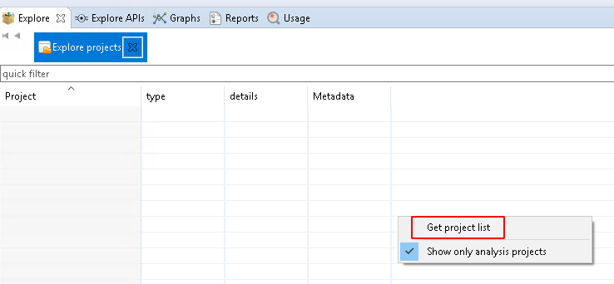
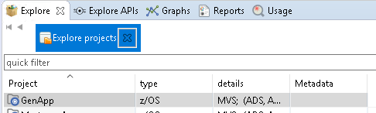
After setting up your ADDI preferences you will need to restart IDz (maybe more than once).
After restarting go to the ADDI Browser perspective. It will look empty, but if you right click somewhere in your screen you can select "get project list" and this will populate your list with all the projects you have.

Slide 38
ADDI Create CBSA using z/OS Agents

Slide 39
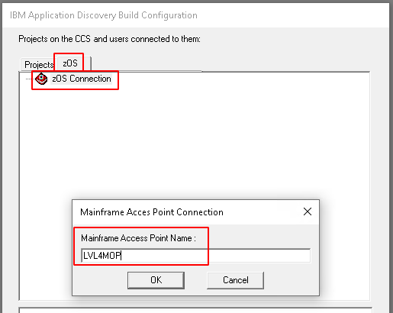

In your Windows start menu open Application Discovery Build Configuration (recognizable by the "bulls eye" icon)
In the window that opens go to the zOS tab, right click on zOS Connection and give it any name you like.

Slide 40
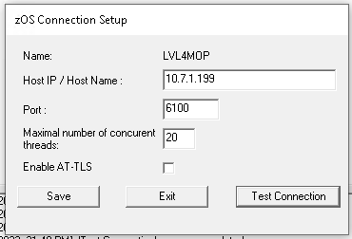

In the popup use
IP address 10.7.1.199
(this is the z/OS LPAR with the CBSA app installed as well as ADDI agents).
Port 6100
Leave the rest default and test your connection. When this is successful click save and then exit.
This will create a new connection with the name you just defined.

Slide 41
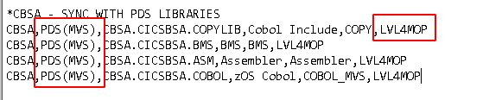
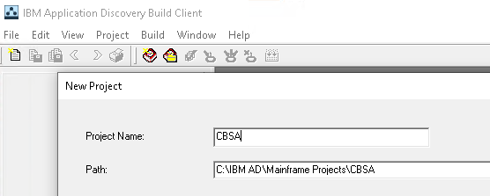
Now go to the sync.txt file (C:\Users\Administrator\Desktop\data\SyncFile.txt) and locate the entry for CBSA.
Here you will have to make a change and at the end of every line change "ZDT" for whatever name you gave your connection.
Also notice the difference with the GenApp entry near the beginning of each line, and the use of dataset names instead of a windows path etc.
Back in the Discovery Build Client create a new project called CBSA (like you did before with GenApp, again, the name has to be exactly like in the Sync file).

Slide 42
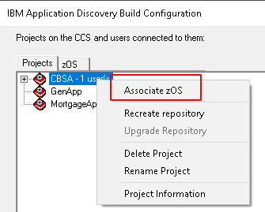
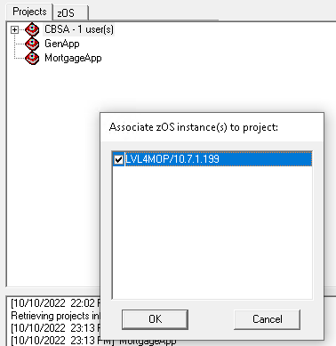
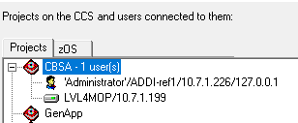
After you have created the CBSA Application in the Build Client go back to the Build configuration to link the application to the z/OS definition you just created (you may have to do a refresh).
Right click on CBSA and select "Associate zOS".
Because we have only defined one zOS configuration you have only one choice, as you probably would in a PoC, but in a real customer environment you may have multiple for multiple LPARs. So select that one and press OK.
Afterwards it should look like this:

Slide 43
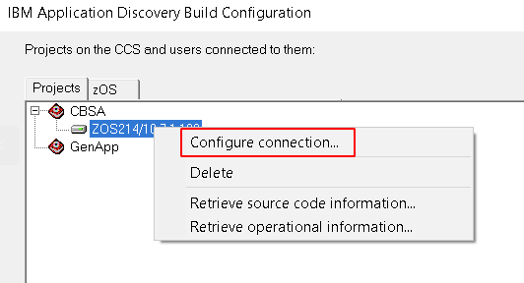
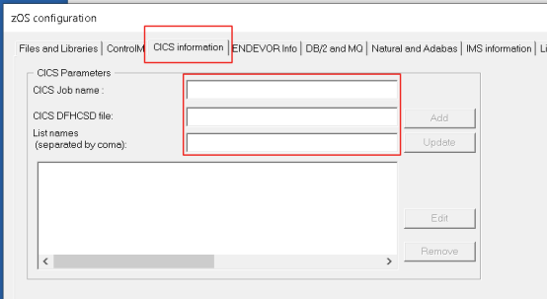



Retrieve the CSD info from CICS
Get the information from the "inputs.txt" file in the data folder
Then go back to the Build client and do a "Make" (which is like a build, but only takes the delta)

Slide 44


Now go back to the Build Client again and do a Synchronize Members.
Like with the GenApp application this will create content in the folders, but this time it didn't get the information from your local hard disk, but directly from the Mainframe.
Output looks like this: (and do double click that line and have a look at what it did)
Now before we do a build of CBSA we run a check to see if we are missing anything, and yes we are:
We ask the customer about it and they tell us that they forgot to mention the copybooks that are created during the build of the application (using the JCL): "If it was built using JCL, the copybook members ought to be in CBSA.CICSBSA.DSECT"
So you will need to fix that issue first before you do a build.

Slide 51
ADDI Configuration Wizard - Upgrade
Presentation
*5 screens for Upgrade Installations

Slide 52

Presentation

Slide 53


Slide 54

Presentation

Slide 55

Presentation

Slide 56

Presentation

Slide 57
ADDI Key Components and Data Flow
Presentation
*Core components

Slide 58


DashBoard
AD
Analyze Clients
Reads data from SQL/DB2
Reads/Writes data in ODB
MAINFRAME
AD Connect
ODB - Graph Database
BATCH SERVICE
MS SQL /
IBM DB2 LUW
AD
Build Client
Parses and stores the source code data
Collects and Process Data
Stores Data
Source code download
GDB Import
GIT Server
GIT Commands
Collects and Process Data
Expose Data
ADI,
zD&T, Web UI
Web Services
Create project, Get Source code, Build
Post Build, Analysis, Integration with ADI and zD&T

Slide 59
What have we covered so far?
Installation
Configuration
Key Components and Data Flow
ADDI Dash Board
ADDI Build Client
ADDI Analyze Client

Slide 60
ADDI Dashboard:
Presentation and Hands On
Configure and maintain components
Monitor:
Components
Projects
Usage

Slide 61
ADDI Build Client and the Mainframe Projects
Core and main component of ADDI – Data Provider
What is it used for?
Project’s creation
Source Code handling:
Retrieves and keeps in SYNC
Parses (Builds)
Stores - in relational repositories and from various places
Who is using it – ADDI administrator personas

Slide 62
What is a Mainframe Project?
“Placeholder” for the source code to be analyzed
Everything is around the Projects
Key things about the ADDI Mainframe Project:
1 Project -> 1 Relational Database Repository (SQL)
One, many or a subset of a Host Application
Handle source code from different technologies (Cobol, Assembler , PLI, Natural)

Slide 63
ADDI Build Client
Hands On
Create Projects
Populate Projects (local sources and remote)
Check Project
Build Process and Build report
Keeping projects up to date

Slide 64
How to handle projects when the source code is based on the host side – PDS Libraries?
Demo
Create a zOS Connection - ZDT
Populate projects automatically:
CBSA Project
PDS Libraries: CBSA.CICSBSA.COPYLIB, CBSA.CICSBSA.BMS, CBSA.CICSBSA.ASM, CBSA.CICSBSA.COBOL
CICS Information – extracted from the CICS System
JKEBank Project
PDS Libraries: JKEBANK.CBL and JKEBANK.INC
DynamicCalls
Local Sources
Project Updates:
Synchronize Projects - JKEBANK
Incremental Builds - Make

Slide 65
Projects Update Scenario for PDS Libraries
Demo
Update a Program – JKEBANK.CBL(JKEMLIST)
Update a Copybook – JKEBANK.INC(JKEMTCOM)
Add a Program – JKEBANK.ADD(JKEFINT)
Delete a Program – JKEBANK.CBL(JKEFINT)

Slide 66
What have we covered?
Project’s Creation
Populate Projects
Check Process
Build process and report

Slide 67
How to handle projects when the source code is based on Git Servers
Demo
Retrieve the source code from the Git Server
Git Clone and Git Pull
Populate the project automatically following a Business logic

Slide 68
Use case for analyzing sources located on a Git Server
Demo
Project Finance -> Finance-Applications\SRC
Business logic:
*.PLI -> PLI
*.ASM -> Assembler
*.CBL and *.COB -> zOS Cobol
Project Finance_Subset -> Finance-Applications\CBL
Business logic:
MUO* and IP* - > Cobol Subset
JKECSMRT and SOURCE - > Cobol Subset 1
STG* and SC0ATACK -> zOS Cobol

Slide 69
Handling Unresolved Dynamic calls
Demo
WS-DATASTORE-PROG -> SAFCICSM
WS-DISPATCH-PROG -> SAFCICNM
WS-STOCKMANAGER-PROG -> CUSTOM1
WS-CATALOGMANAGER-PROG -> CUSTOM2
CATMAN-PROG -> CUSTOM3
-> CUSTOM4
-> CUSTOM5

Slide 70
Automation Flows in ADDI – Use Case
Create 2 projects: AutomationFlows and ATF
Make sure they are configured for periodic updates
Delete one very old project that is confusing us: Accounting2021
AutomationFlows project details:
Sources are based on the ZDT Lpar
Libraries to be loaded in ADDI
CHEF.CBL1 - Cobol Programs
CHEF.CBL.INC- COBOL Copybooks
CHEF.JCL - JCLs
CHEF.JCL.PROC - JCL Procs
CHEF.JCL.CTRL - JCL Control Files
CHEF.JCL.INCLUDE - JCL Include
CHEF.PL1.INC - PL1 Include
CHEF.ASM - Assemblers
Data from our CA7 system to be loaded as well.

Slide 71
Automation Flows in ADDI – Use Case
Demo
ATF project details:
Sources are based on our Git Server
Repository name is: JKEBANK
Folders to be loaded
Cobol Programs
Cobol Includes

